Slide 1

Bohol and Cebu
M A R K E T R E S E A R C H O F
Where should Chilton Worldwide build it’s next hotel?
Jerico Aragon · Sean Flores · Elaiza Padilla
JUNE 1, 2019
Notes:
The Chilton CEO wants you to present your findings in a presentation which summarizes your work and give recommendations on what are the ideal qualities of the hotel that Chilton should build in this city.

Slide 2
Agenda
Context and Objectives
Methodology
Key Findings
Implications and Next Steps

Slide 3
Context and Objectives
SITUATION
Conduct market research using TripAdvisor’s data on where Chilton Worldwide’s next hotel should be built
Objective
Provide a recommendation what are the ideal qualities of the hotel that Chilton should build in this city.

Slide 4
Methodology
KEY QUESTION
Which city and what type of hotel have a higher market potential?
Preparation
Modelling
Synthesis
Scrape all hotel listing available in Trip Advisor for Bohol and Cebu
We analyzed 526 hotels
Identify indicators that might be correlated with demand
We compared hotel attributes such as hotel star rating, location, and price point
We utilized modelling outputs to select the best city and hotel class to build

Slide 5
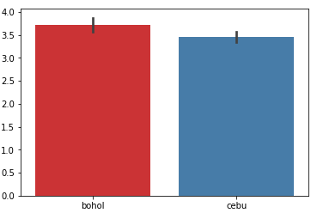
Average Satisfaction Rating
Rating
Travelers are generally happy with hotel service for both cities
City
There is insignificant difference on satisfaction rating for both cities

Slide 6
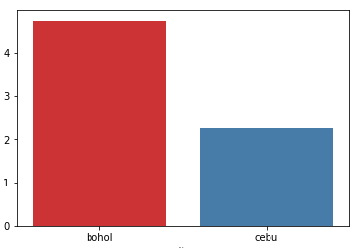
Ratio of No. of Hotel and Demand
Ratio
Total number of reviews divided by total number of demand
Assumptions:
Number of reviews indicates demand
Number of hotels in TripAdvisor is correct
Number of hotel capacity is the same with Bohol and Cebu
City
Bohol have a higher demand for hotels
Notes:
Define assumptions -

Slide 7
Qualitative Research
Tourism Growth
Tourism in Bohol has grown at an impressive annual rate of 25.2 percent from 2011 to 2017
New Bohol-Panglao airport
Can accommodate over 2 million passengers annually, more than double the 800,000 annual passenger capacity of the Tagbilaran airport.
12th most competitive province
Bohol now ranked Central Visayas Number 1 based on Cities and Municipalities Competitiveness Index.
We are recommending building a hotel in Bohol
Notes:
four pillars as indicators: economic dynamism, government efficiency ,infrastructure and resiliency.

Slide 8
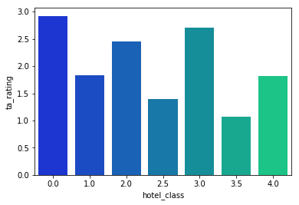
Estimated Revenue of Each Hotel Class
TripAdvisor Rating
Revenue = (Price of Service) * (Demand)
Assumptions:
Revenue is directly proportional to profit
Demand is directly proportional to the number of reviews
Hotel Star Rating
3-star hotels have high revenue potential

Slide 9
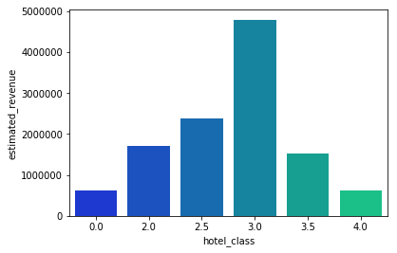
Estimated Revenue and Hotel Ratings
Hotel Star Rating
Hotel Star Rating
There is a market-gap for 3.5 star hotels

Slide 10
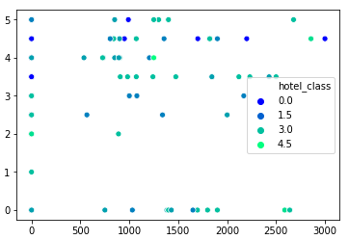
Hotel Room Price and Satisfaction Rating
Rating
Hotel Room Price
There's no significant relationship between Hotel Room Price and Satisfaction Rating

Slide 11
Implications and Next Steps
Unresolved questions
What amenities should we include with the service?
What is the ideal room capacity of the hotel?
Recommend
We recommend investing for a new hotel in Bohol that have at least 3.5 star hotel rating
Analyze the usual amenities and room features 3.5 star hotels offer and see where could add value to customers

